Slide 1
Case Study EDA
Sid Swarupananda
Sean mcWhirter

Slide 2
Case Study Description
Our core datasets includes information from a sample set of 2,410 US craft beers produced by 558 breweries, with specific information such as:
Beers.csv:
Name: Name of the beer (example: Snapperhead IPA)
Beer_ID: Unique identifier of the beer
ABV: Alcohol by volume of the beer
IBU: International Bitterness Units of the beer
Brewery_ID: Brewery id associated with the beer
Style: Style of the beer (example: American Pale Ale )
Ounces: Serving size of the beer
Breweries.csv:
Brew_ID: Unique identifier of the brewery.
Name: Name of the brewery.
City: City where the brewery is located.
State: U.S. State where the brewery is located.

Slide 3
Case Study Analysis
We examined below topics as part of our analysis:
Breweries per state
Median alcohol content per state
Median international bitterness per state
Beers with highest Alcohol by Volume (ABV) and International Bitterness Unit (IBU)
Summary stats of Alcohol by Volume(ABV)
Analysis of relationship between Alcohol by Volume (ABV) and International Bitterness Unit (IBU)
Github repo that contains all information about this analysis is available here. It contains all relevant information such as raw data files, Rmd scripts, R html output, etc.,

Slide 4
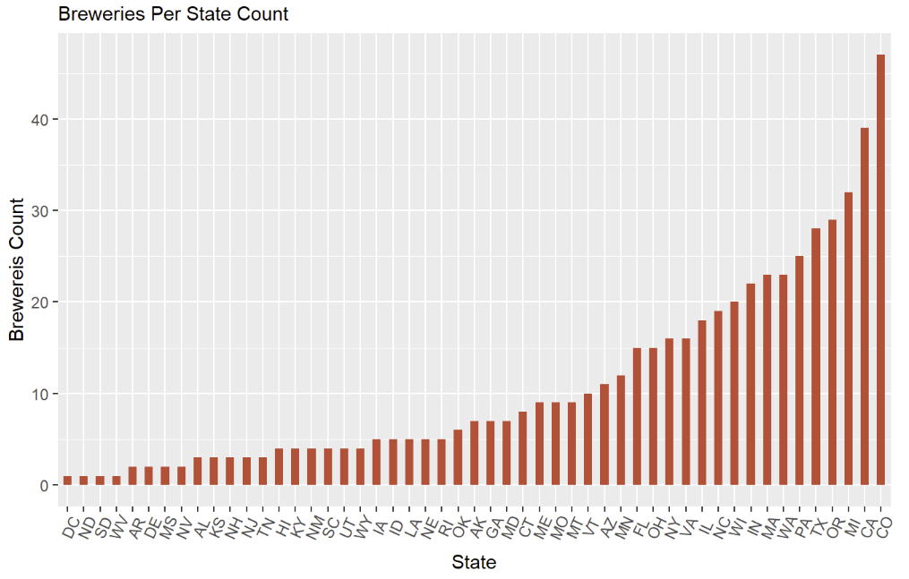
How many breweries are present in each state?
Range of breweries 1 - 47
Colorado leads with 47 breweries
Looking further into this by comparing to population may lead to insights

Slide 5
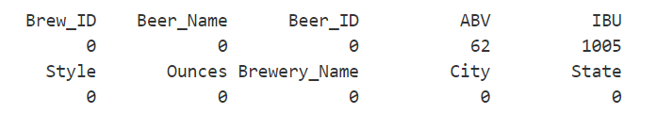
Address the missing values in each column
ABV and IBU are the only columns with missing values.
However, since we have a high number of observations, we should be able to omit the missing values and still be able to determine any significant insights.

Slide 6
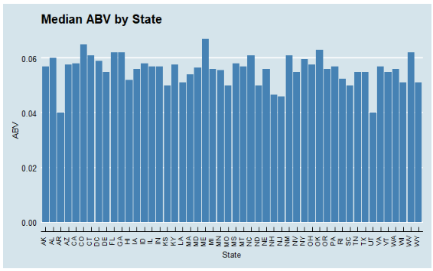
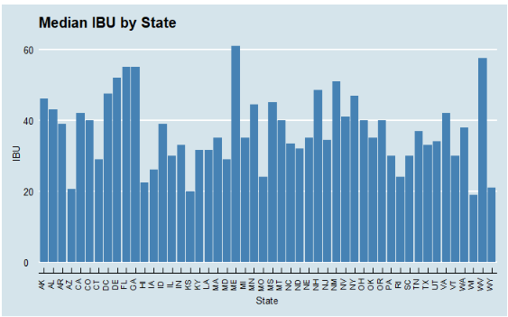
Compute the median alcohol content and international bitterness unit for each state. Plot a bar chart to compare
Median Alcohol content (ABV) is fairly consistent around 6%
Median international bitterness (IBU) per state is very much varied

Slide 7
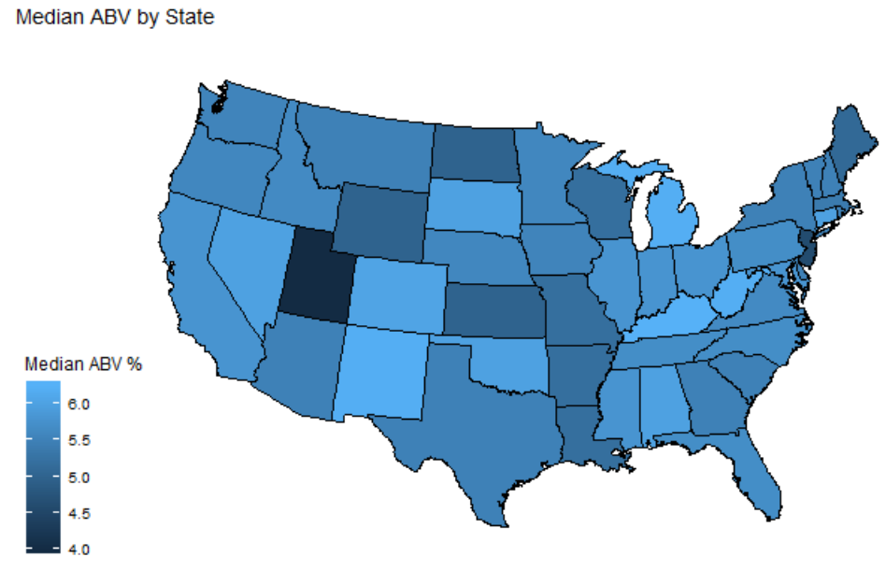
Median ABV by State
Colorado also has the most breweries
OK and NM have fewer breweries

Slide 8
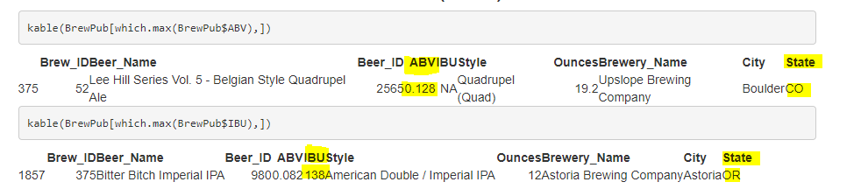
Which state has the maximum alcoholic (ABV) beer? Which state has the most bitter (IBU) beer?
Colorado has the beer with highest ABV at 12.8%
Oregon has the beer with highest IBU at 138

Slide 9

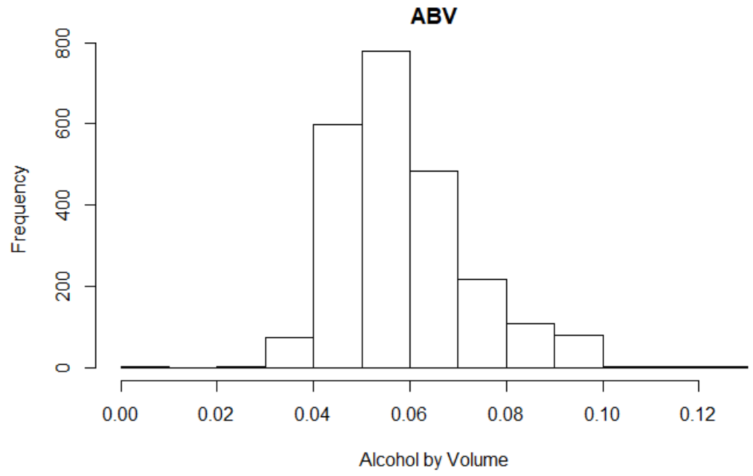
Comment on the summary statistics and distribution of the ABV variable
Some beers don’t even measure 1%. Median was 5.6%, Mean or average was 5.9% and the maximum ABV was around 13%. Also, note that we are missing 62 values in the dataset that we were provided
Looking at a histogram of the data, it seems to be a bit right-skewed. This makes sense because beer is not meant to be a very high ABV drink-the high ABV beers would be more rare.

Slide 10
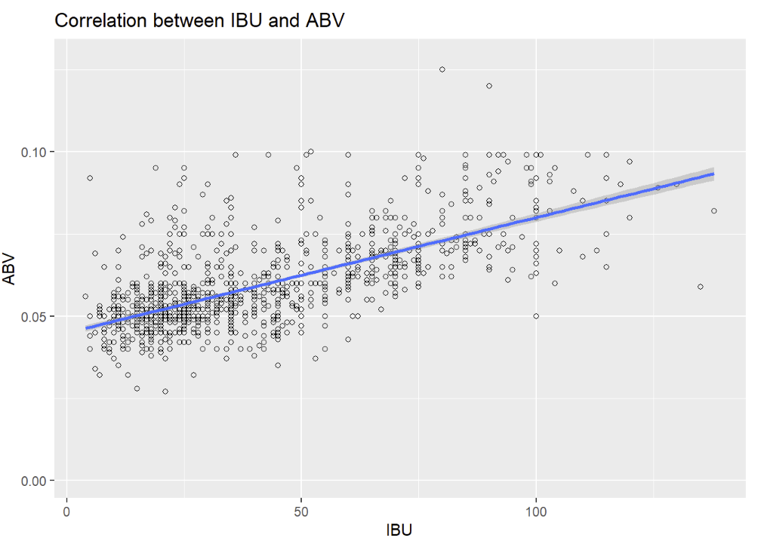
Is there an apparent relationship between the bitterness of the beer and its alcoholic content? Draw a scatter plot.
Visual evidence of a positive linear relationship. Higher the alcohol content higher the beer is on IBV scale, but there are some outliers where we have some beers which are higher in alcohol content but not as high on the bitterness scale.
Further investigation is needed to determine the significance of the relationship

Slide 11
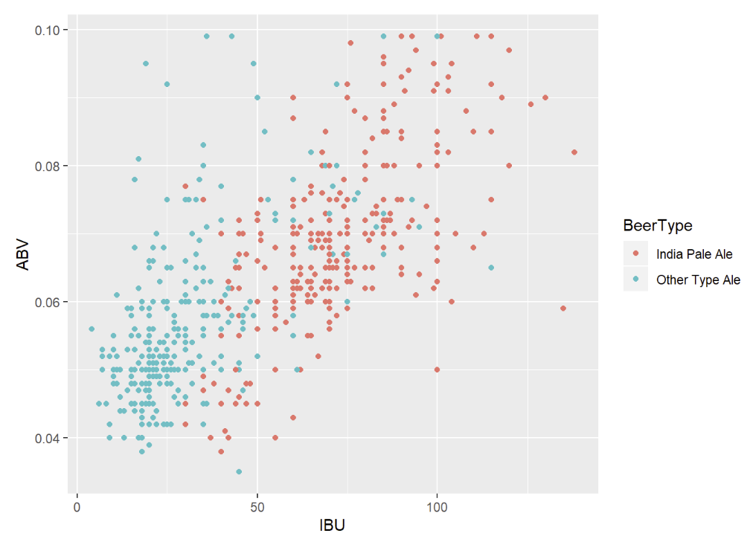
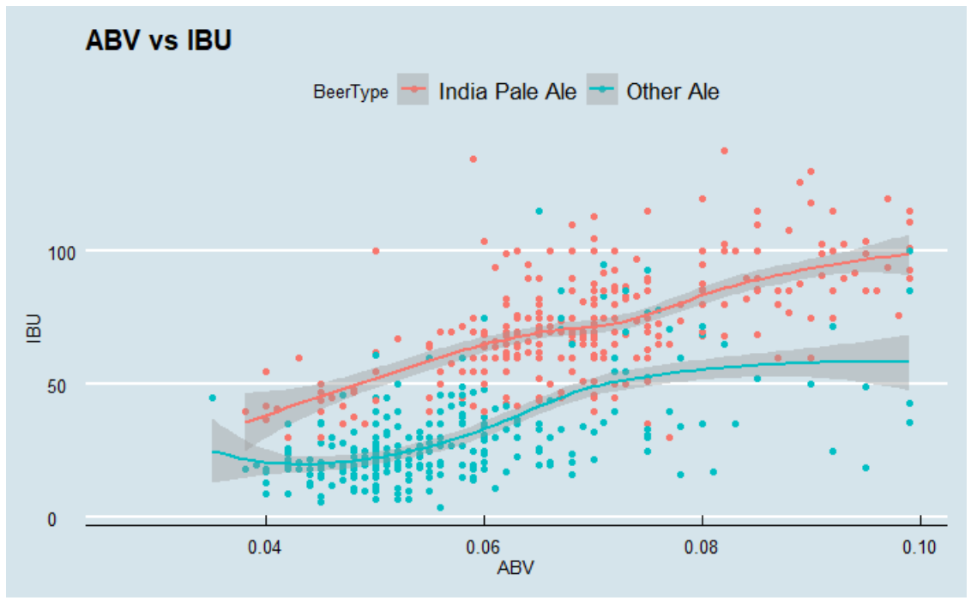
Budweiser would also like to investigate the difference with respect to IBU and ABV between IPAs (India Pale Ales) and other types of Ale (any beer with “Ale” in its name other than IPA)

Slide 12
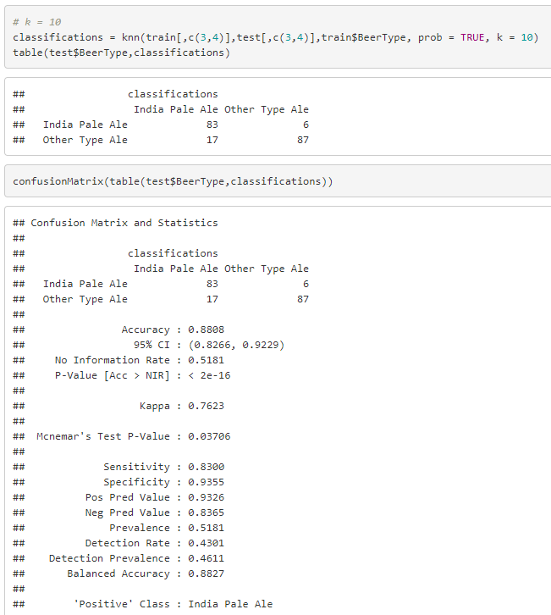
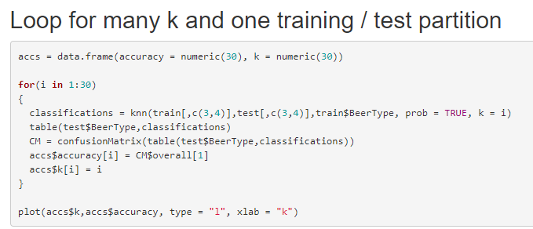
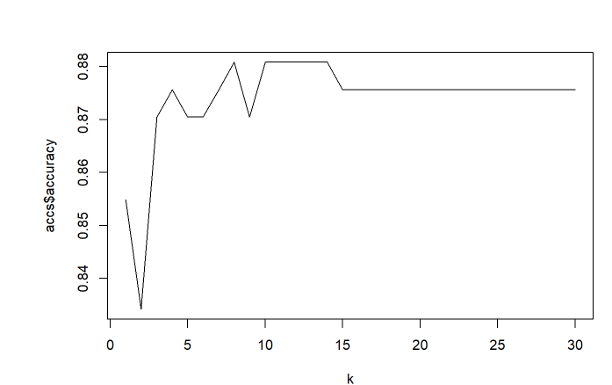
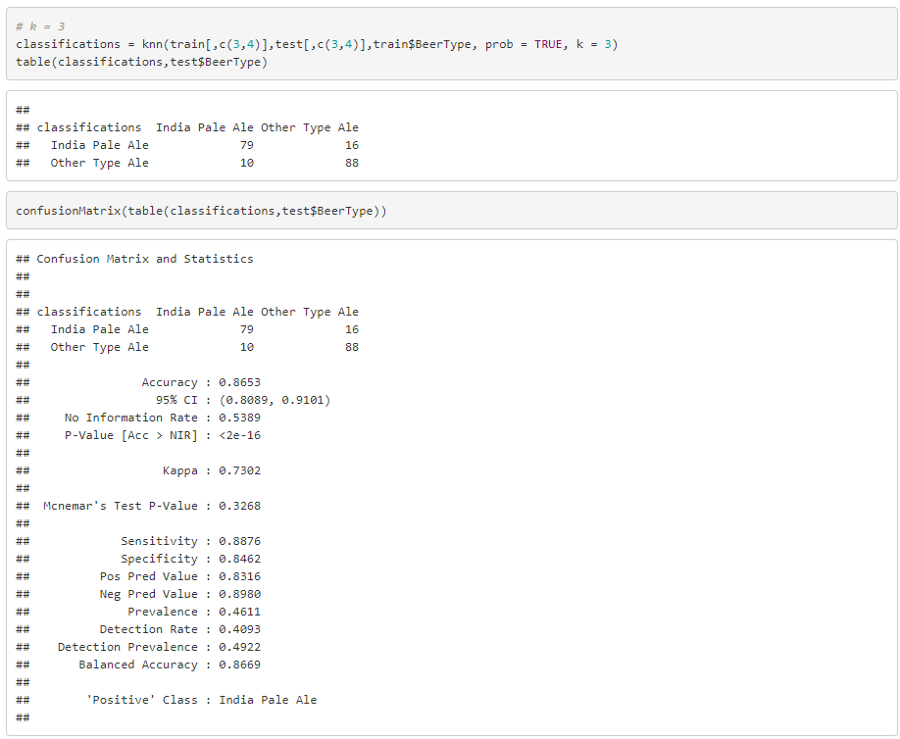
Knn method to investigate the difference with respect to IBU and ABV between IPAs and Other Type of Ale

Slide 13
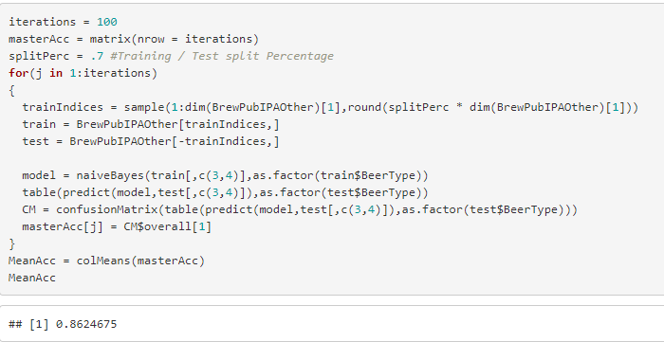
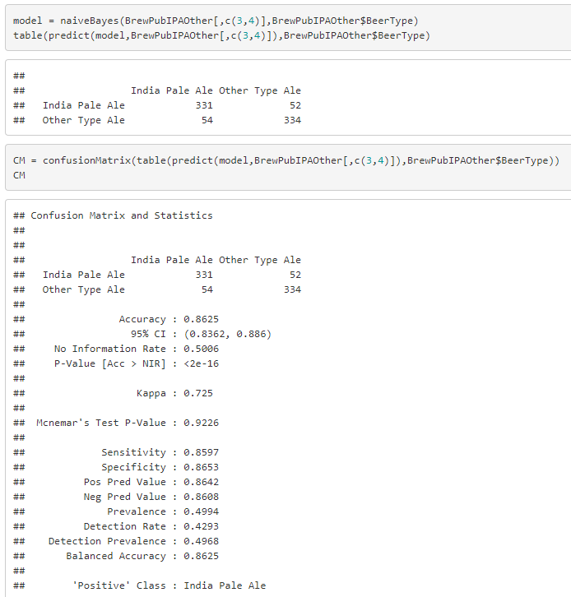
Naïve Bayes method to investigate the difference with respect to IBU and ABV between IPAs and Other Type of Ale

Slide 14
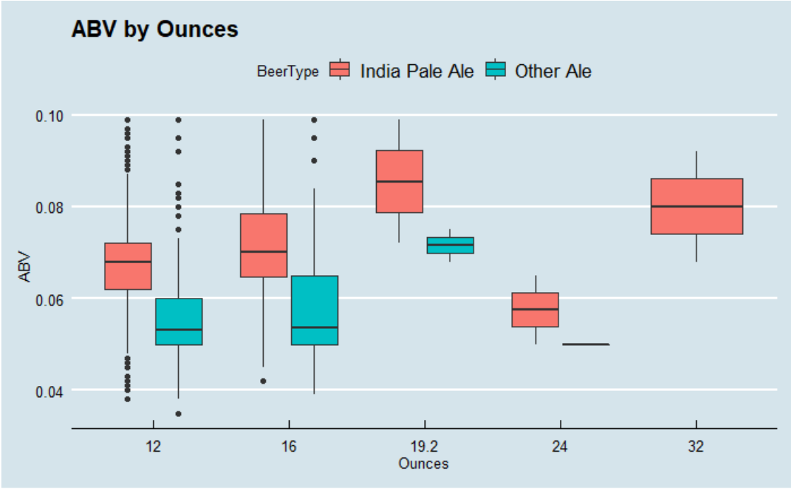
Other Insights
It appears that IPAs have higher median ABV values than other ales.
More of a difficult relationship between Ounces and ABV

